Slide 1


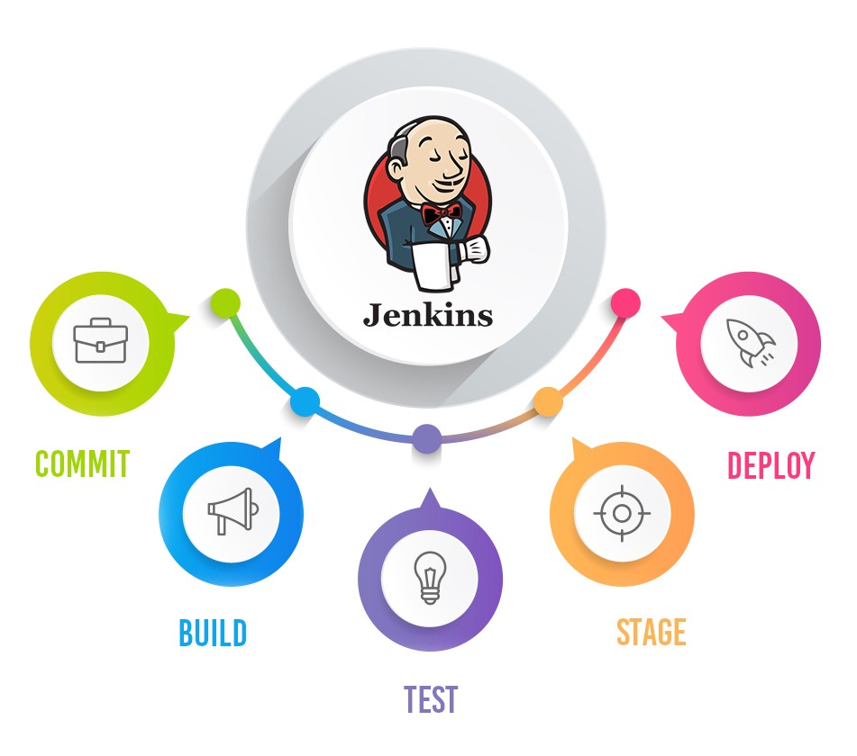
Jenkins Mastery for Software Tester
Pramod Dutta
Why we need to Learn Jenkins as Software Tester

Slide 2
Agenda
Why we need to Learn Jenkins as Software Tester
What is Jenkins?
Quick Demo

Slide 3

What is Jenkins?
An open source automation server which enables developers around the world to reliably build, test, and deploy their software

Slide 5
What is Jenkins?
Suppose we have created selenium automation scripts for regression testing.
Now to run the scripts someone has to manually trigger the execution. Here Jenkins comes to rescue.
Jenkins can be setup on the Cloud or any other machine where automation scripts need to be executed and can be triggered using jenkins build.
Jenkins builds can be scheduled to run on daily basis and this way Jenkins automates the automation process.

Slide 6
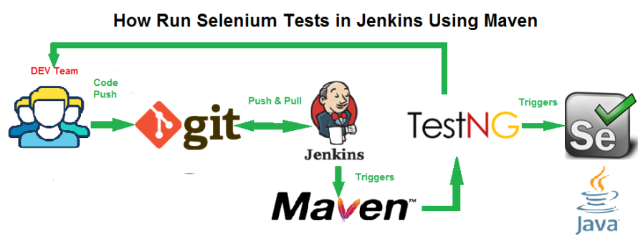
Run API Test on Jenkins
API TC

Slide 7
Run Selenium Test on Jenkins

Slide 8

Why we need to Learn Jenkins as Software Tester
Runs Automated Test Suites
Run you Web, Mobile Automation SUITE
API Monitoring
Report and Email Notification
Trends and detailed failure that can be shared.
You can use slave to make build and run fast.

Slide 9
Lets See Jenkins Job Demo
Demo Jenkins job

